Slide 1
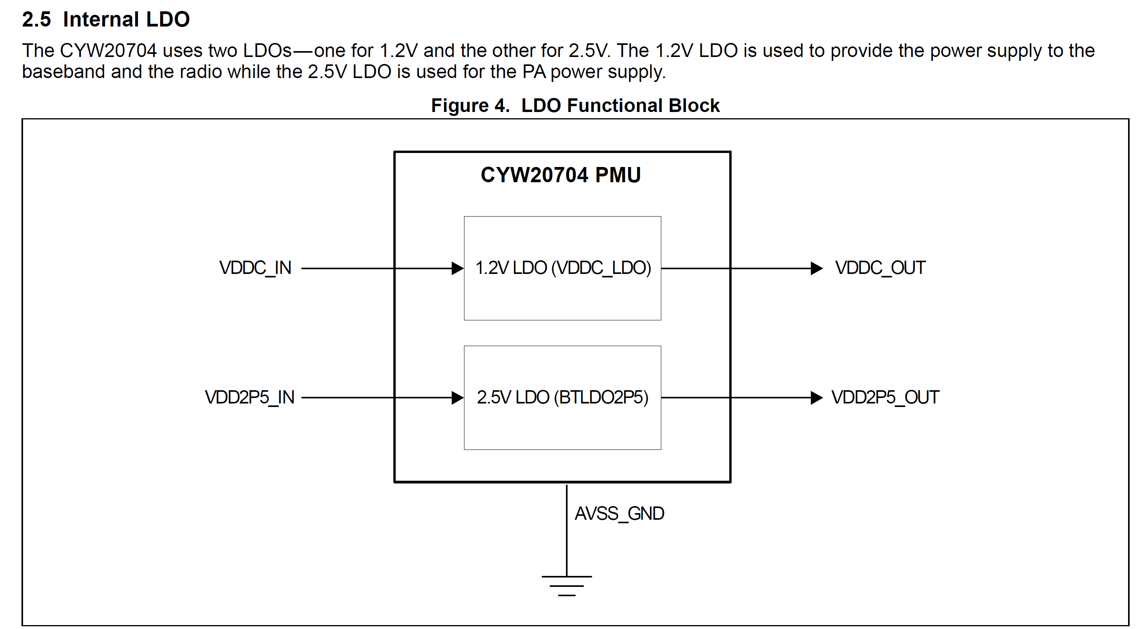
1. Which pin is VDDC_IN?
Pin assign
VDDC_IN:
VDDC -> B8, G6
Pin assign
VDDC_OUT:
F1

Slide 2
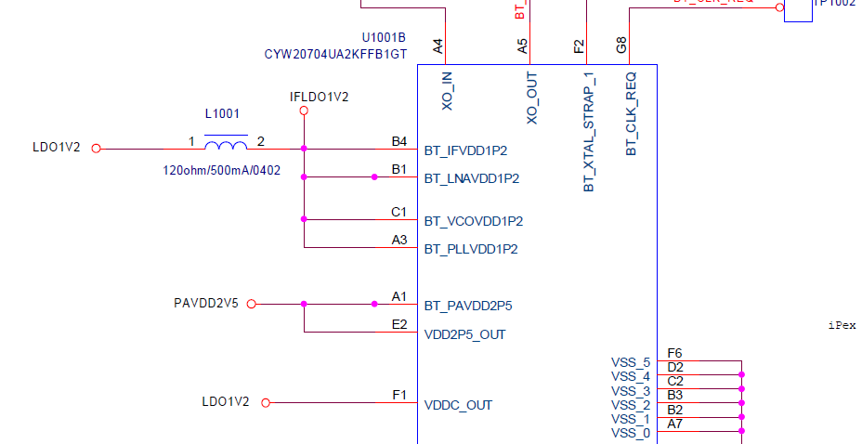
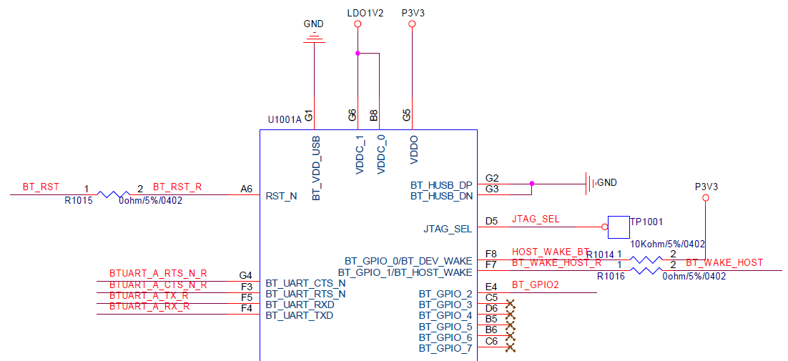
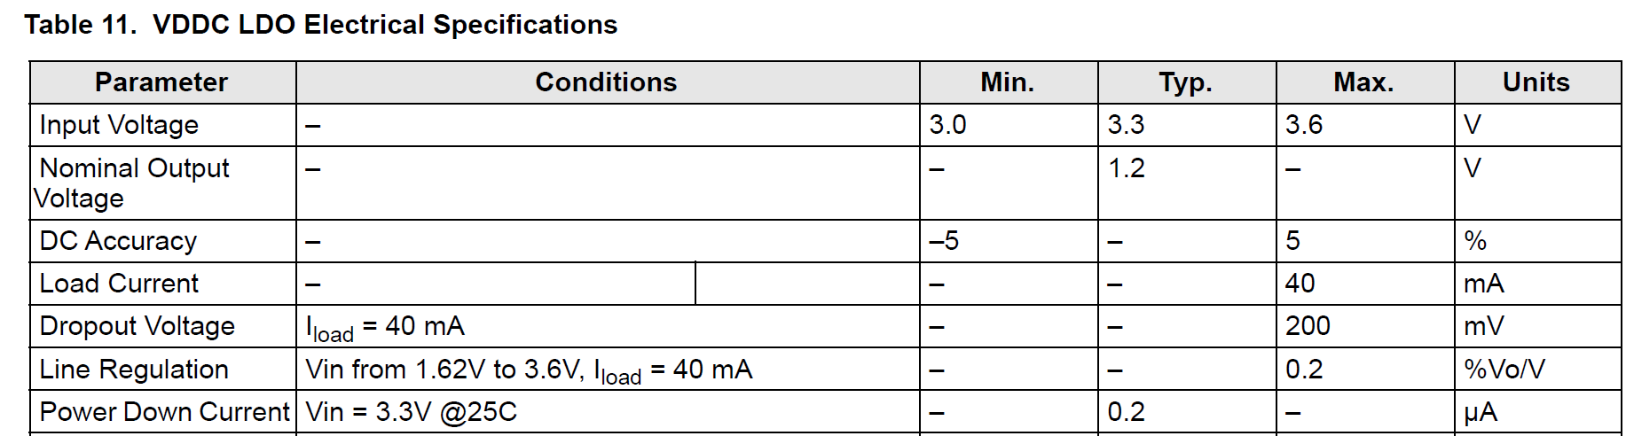
Which pin is VDDC_IN?
If VDDC_IN is VDDC(B8,G6), your schematic is wrong.
Your schematic presented VDDC_OUT(F1) -> VDDC_0 &1(B8, G6): Power flow
And VDDC Input voltage range presented to 3.0~3.6V(refer to below specification)

